Slide 1
Multivariate Modeling (DATS 6450) - Final Term Project
Student: Srijon Mukhopadhyay
Instructor: Dr. Reza Jafari

Slide 2
I’ve chosen a dataset consisting of the daily climate observations in Delhi from 2013 to 2017. The goal will be to make forecasts on the humidity observed.
The data set has:
Four columns - Mean Temperature, Wind Speed, Humidity and Wind Pressure
1575 rows, or observations
A time step of one day for every observation
My dependent variable will be Humidity.

Slide 3
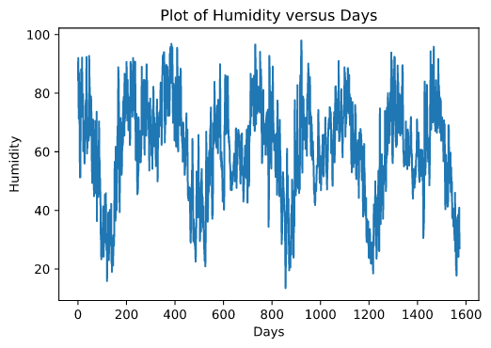
Here’s how my dependent variable Humidity looks over time:

Slide 4
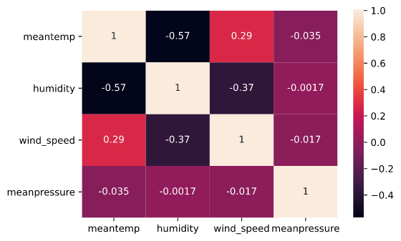
The correlation matrix for all my variables:

Slide 5
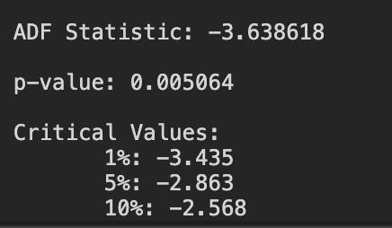
Testing the stationarity of the dependent variable:
I can reject the null hypothesis that the data is non-stationary.

Slide 6
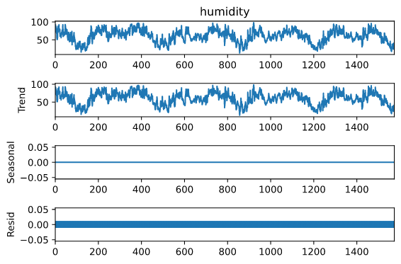
Time series decomposition:
Additive Model:

Slide 7
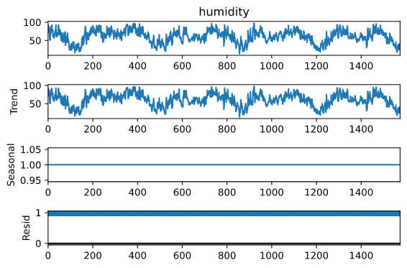
Multiplicative model:

Slide 8
Holt-Winters Model
I’ll first fit my data using the Holt Winters model. Here’s the characteristics of the model I’ve fit:
Fit with the training data (80%-20% split)
There is no trend specified as a parameter in the model
The model is additive
I’ll make some forecasts next and compare them with the test set.

Slide 9
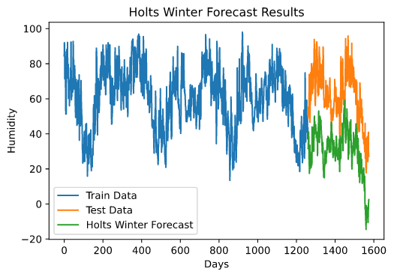
Let’s look at how my forecasts did on a plot:

Slide 10
Here’s how the Holts Winter Model did:
The variance of the residuals is 168.90 (approx)
The mean of the residuals is 30.51
The RMSE of the model is 33.16
I can tell by the mean of the residuals that this estimator is a biased estimator. The residuals are not white and uncorrelated.
Next, I’ll try a Multiple Regression Model on my data using the same training test split of the data.

Slide 11
Multiple Regression Model
I ran a fit of the OLS function on the data:
As suspected, my Mean Pressure dependent variable did not pass the test. I’ll remove it and run another test.
The F-test statistic looks good.
The AIC and BIC values are high, which I suspect may be due to the lack of a high enough correlation between the dependent and independent variables.

Slide 12
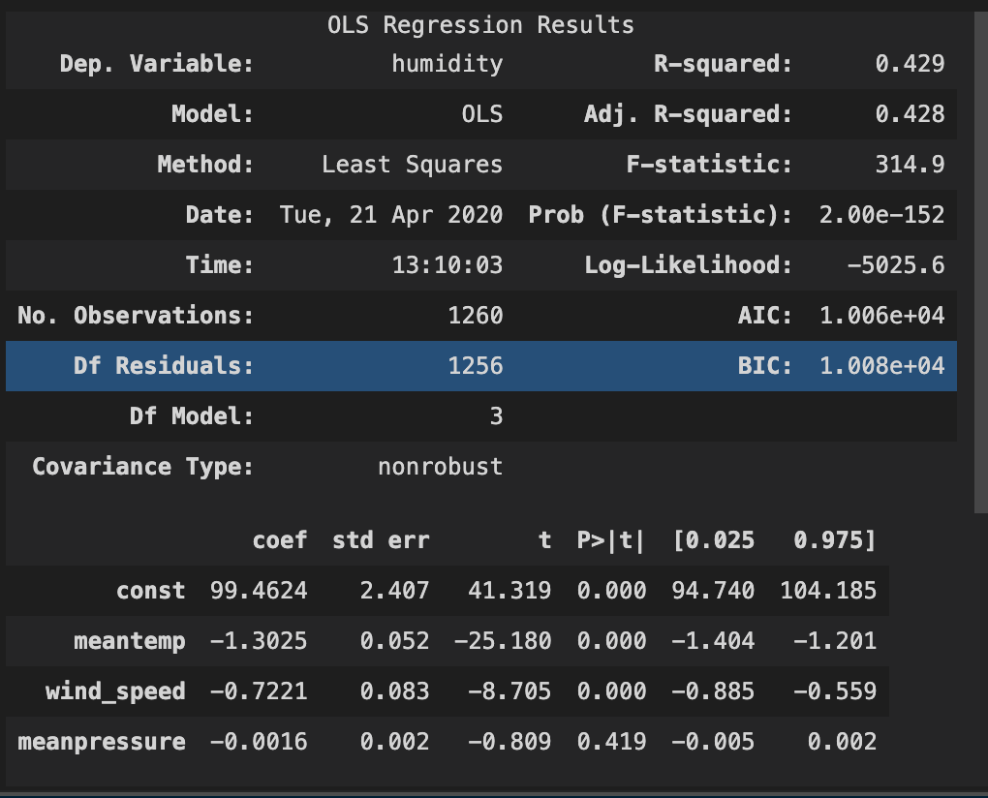

Slide 13
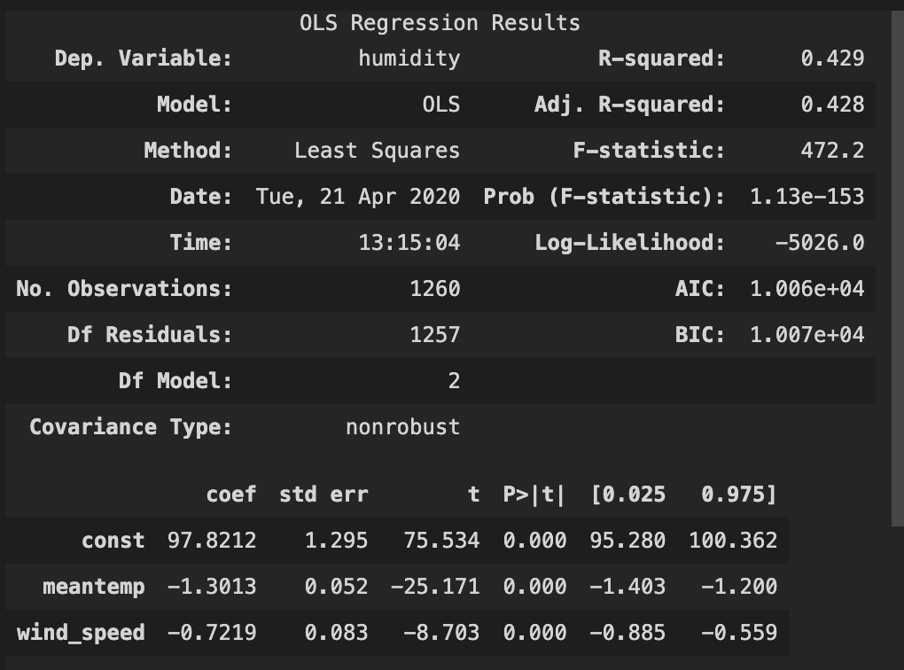
Running another fit after removing Mean Pressure, my model does better:
All the coefficients are significant
The R-squared and Adjusted R-squared models are still pretty low
The AIC and BIC values are pretty high

Slide 14
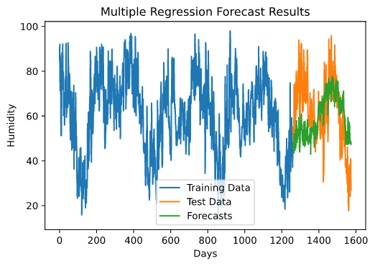
Looking at the residuals of the regression forecasts:
The variance of the residuals is 214.64
The mean of the residuals is 2.08
The Q value is 2299.8
The RMSE is 14.80

Slide 15
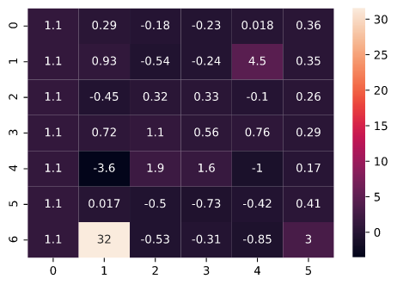
ARMA MODEL
Using the theoretical autocorrelations, I’ve generated a GPAC table that best represents the dataset.
From this, I’ll choose the ARMA(1,0) and ARMA(2,5).

Slide 16
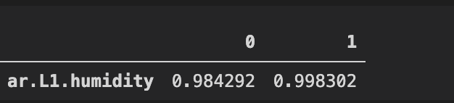
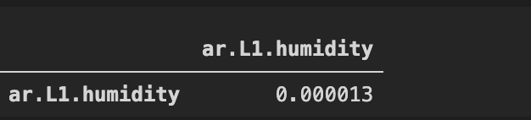
ARMA(1,0)
The ARMA(1,0) model generated had a coefficient of 0.99.
The confidence intervals:
The covariance matrix:

Slide 17
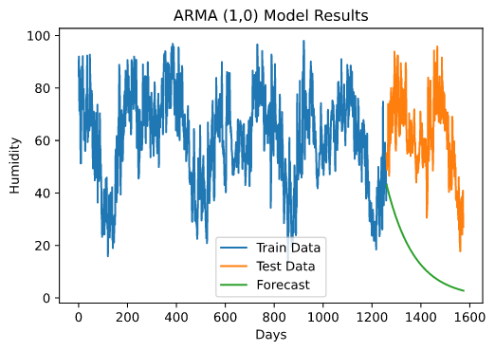
The confidence intervals do not include zero. This means the estimated parameters are important
The estimated variance is 252.05
The mean of the residuals is 46.66. The estimator is thus a biased estimator
The RMSE of the model is 49.29

Slide 18
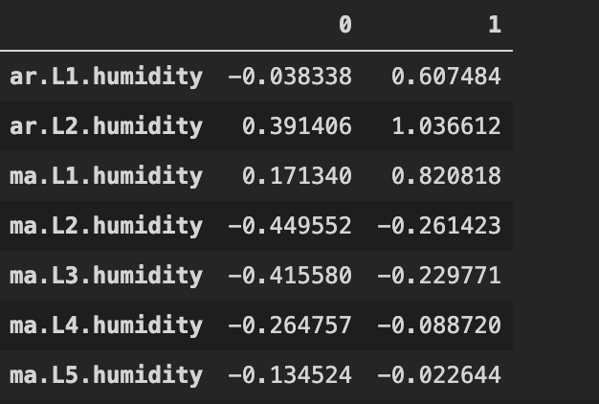
ARMA (2,5)
The ARMA(2,5) model has estimated AR parameters of 0.28 and 0.71. The estimated MA parameters are 0.49, -0.36, -0.32, -0.18, and -0.08.
Confidence intervals:
The first AR parameter has zero in its confidence interval. This suggests that the estimated paramters are not important.

Slide 19
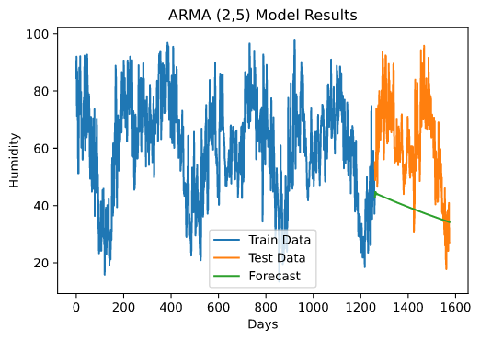
The mean of the residuals is 22.27. The estimator is thus biased
The variance of the residuals is 210.97
The RMSE is 26.60

Slide 20
Chi Square Diagnostic Test
Unfortunately, both the models did not pass the Chi Square Test. This suggests that the residuals are not white and both models are biased
As a side note, none of the GPAC order combinations passed Chi Square Test
I also tried to subtracting the mean and fitting the model and adding the mean back to the predictions to relax the Q score. That did not work either

Slide 21
Choosing a Final Model Based on Performance:
Based on the performance of all three models, I would choose the Multiple Regression Model over all three for these reasons:
While it’s a biased estimator, it is able to capture the seasonality of the data better than the Holts Winter and ARMA models.
The residuals of the regression model have a much lower mean than the residual means of the Holts Winter residuals
The Regression model has a much lower value of RMSE than the other two models

Slide 22
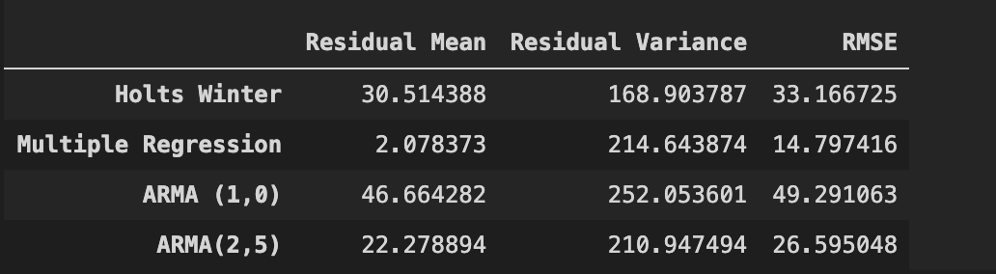

Slide 23
Comparing Plots

Slide 24
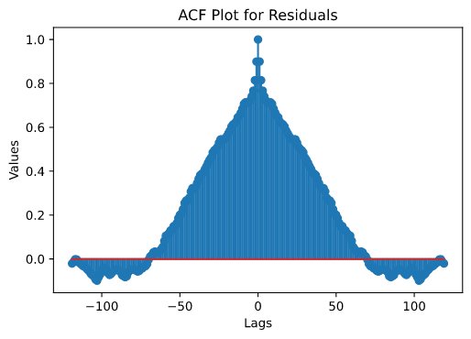
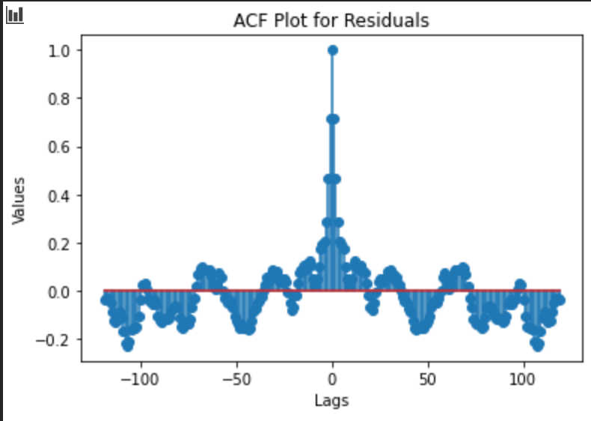
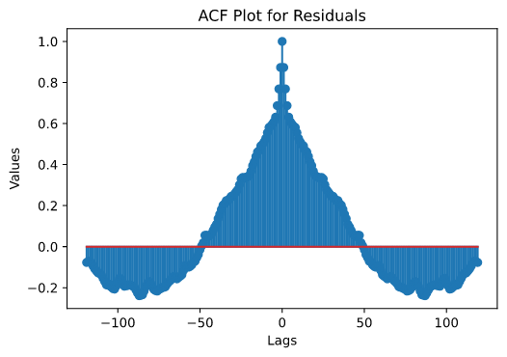
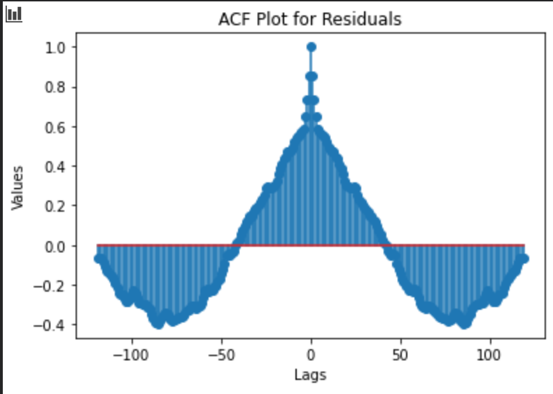
Holts Winters Residuals ACF
Regression Residuals ACF
ARMA models

Slide 25
Summary and Conclusions
One reason for the ARMA models not passing the chi square test could be the ARMA model lacking an intercept
All three models struggled a bit, most probably due to nature of the data. My data is records daily observations for a long period of time (four years) and thus involve multiple seasonal patterns and complex seasonality
A way to fix this and may be extend this project could be to implement dynamic harmonic regression algorithms that may be able to account for the complex seasonality of the model
The regression model would definitely do better with more features. It may be suffering from underfitting

Slide 26
Thank You!

